Slide 1
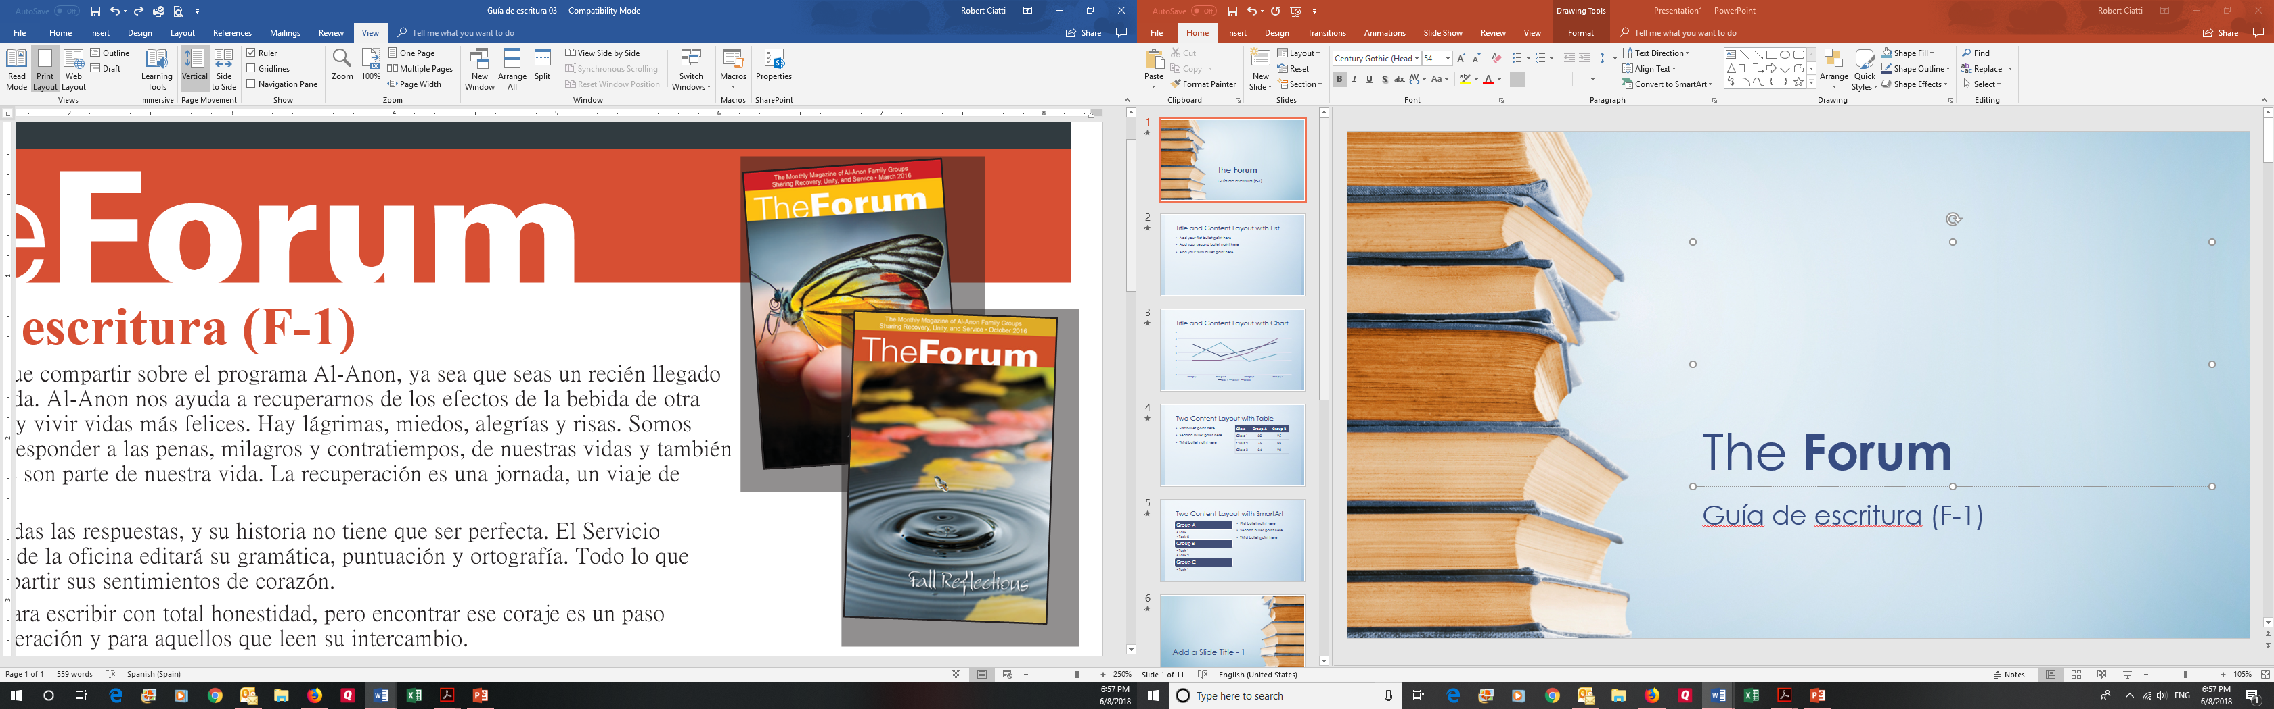
The Forum
Writing Guideline (F-1)

Slide 2
The Forum Writing Guideline (F-1)
Everyone has something to share about the Al-Anon program, whether you are a newcomer or longtime member.
  Al-Anon helps us to recover from the effects of someone else’s drinking, to improve and live happier lives.
  There are tears, fears, joys and laughter.
  We’re able to address and respond to the sorrows, miracles, and setbacks, as well as take steps forward that are part of life.
  Recovery is a journey.

Slide 3
The Forum Writing Guideline (F-1)
You don’t have to have all the answers, and your story doesn’t have to be perfect.
  The World Service Office staff will edit for grammar, punctuation and spelling.
  All you need to do is to share from heart.
It takes courage to write with complete honesty, but finding that courage is a step forward toward recovery for you and those who read your sharing.

Slide 4
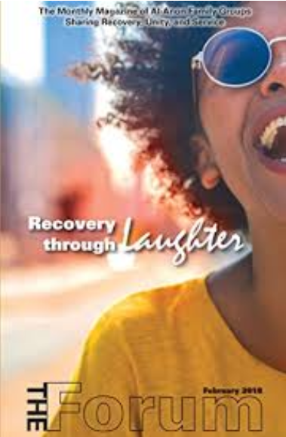
The Forum Writing Guideline (F-1)
Word count for Forum features:
Standard sharing—300 to 400 words
“Our Three Legacies” sharing (a Step, a Tradition or a Concept of Service)—300 to 400 words
My Story”—1,200 words
“Zip 23454”—50 to 200 words
“One Quote at a Time”—25 to 50 words

Slide 5
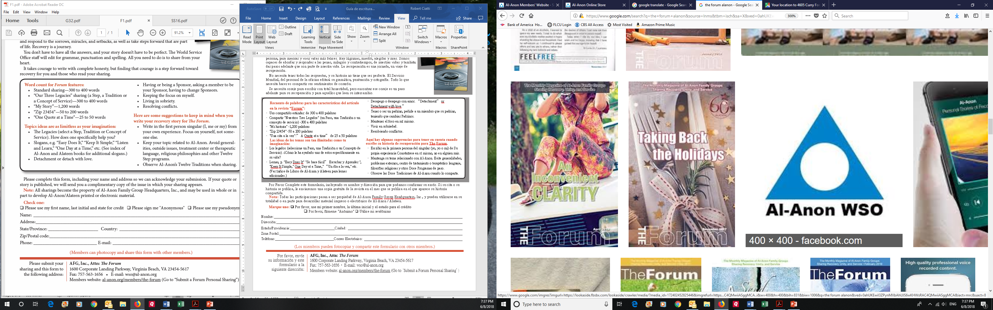
The Forum Writing Guideline (F-1)
Topics ideas are as limitless as your imagination:
The Legacies (select a Step, Tradition or Concept of Service). How does one specifically help you?
Slogans, e.g. “Easy Does It,” “Keep It Simple,” “Listen and Learn,” “One Day at a Time,” etc. (See index of Al-Anon and Alateen books for additional slogans.)
“Detachment or detach with love.”
Having or being a Sponsor, asking a member to be your Sponsor, having to change Sponsors.
Keeping the focus on myself.
Living in sobriety.
Resolving conflicts.

Slide 6
The Forum Writing Guideline (F-1)
Here are some suggestions to keep in mind when you write your recovery story for The Forum:
Write in the first person singular (I, me or my) from your own experience. Focus on yourself, not someone else.
Keep your topic related to Al-Anon. Avoid generalities, outside issues, treatment center or therapeutic language, religious philosophies and other Twelve Step programs.
Observe Al-Anon’s Twelve Traditions when sharing.

Slide 7
The Forum Writing Guideline (F-1)
Share your Story

Slide 8
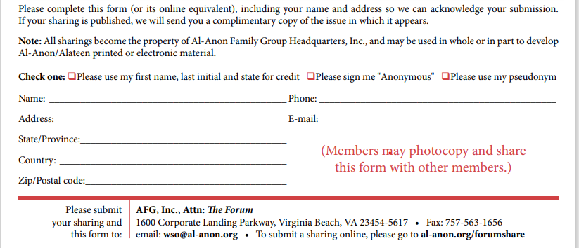
SUBMIT YOUR COMPLETED WRITING

Slide 9
The Forum Writing Guideline (F-1)
REFLECTION TOPICS TO WRITE ABOUT

Slide 10
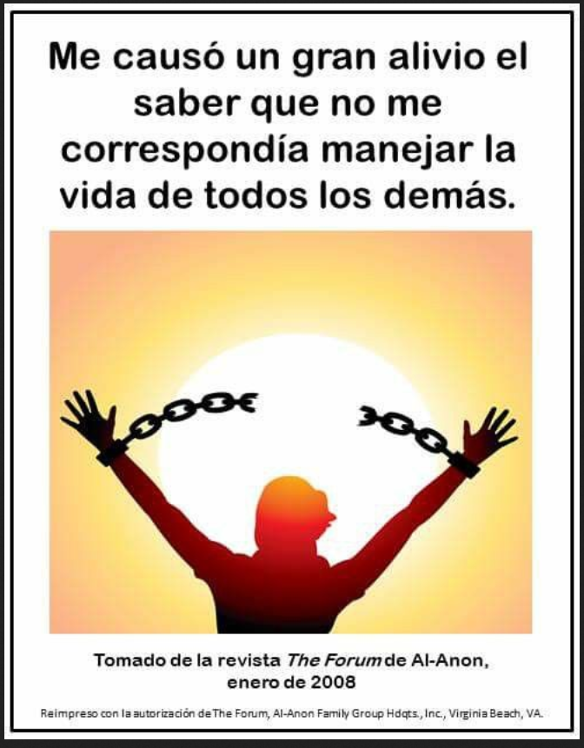
The Forum Writing Guideline (F-1)
It gave me relief to know that I was not responsible to control everyone else’s lives.
What Al-Anon slogan(s) do you use the most? Why?
What makes your HOME GROUP special?
When I attended Al-Anon, I learned that I am special because...
What areas of your home, workplace or life have changed by attending Al-Anon?
How have you learned to take care of yourself with recovery in Al-Anon?
What makes you return to Al-Anon meetings?
My feelings are hurt. Please listen to me".
What do you mean?
Do you feel guilty about something? How has Al-Anon helped you through this FEELING?
Taken from The Al-Anon Forum magazine
January of 2008
Reprinted with permission from The Forum , Al-Anon Family Group Hdqtrs, Inc. Virginia Beach, VA

Slide 11
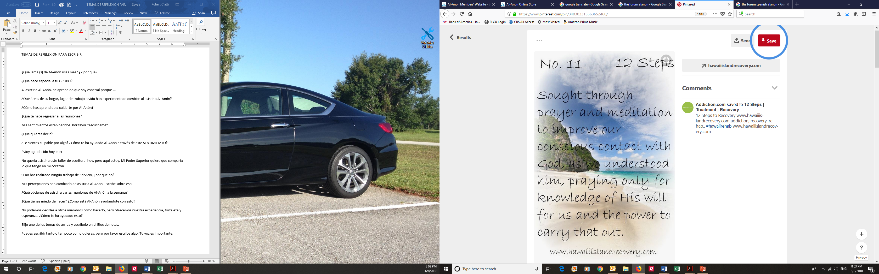
The Forum Writing Guideline (F-1)
Today I am grateful for…
I did not want to attend this writing workshop, today, but here I am. My Higher Power wants me to share what I have in my heart.
If you have not done any Service work, why not?
My perceptions have changed from attending Al-Anon meetings. Write about that.
What do you get from attending several Al-Anon meetings a week?
What are you afraid to do? How is Al-Anon helping you with this?
We cannot tell other members how to do it, but we offer our experience, strength and hope. How has this helped you?
Choose one of the topics above and write it in Notepad.
You can write as much or as little as you want, but please write something. Your feelings are important and can help other members.

