Slide 1
2024 Public outreach project
Carmen S
Public Outreach Coordinator​

Slide 2
area public outreach coordinator G-38 – Guidelines https://al-anon.org/pdf/G38.pdf
“Public Outreach informs the general public through the media, professionals, facilities, and organizations about who we are, what we do, and how to get in touch with us. Our goal is to attract to our program those whose lives are or have been affected by someone else’s drinking, so that those who need our program can find the help and hope we offer. We also strive for name recognition and credibility as a community resource.”
From Louis Remembers… “If…Al-Anon groups do not let the public know of our presence, perhaps by announcing the time and place of meetings in local newspapers or by some other means, we block ourselves off from those in need.” (page 194).

Slide 4
Public outreach service g-10 Al-Anon/Alateen https://al-anon.org/pdf/G10.pdf
What is the Purpose for Outreach to the Public?
To inform the public about Al-Anon/Alateen
To inform media of how Al-Anon/Alateen can help families and friends of alcoholics.
To obtain media coverage of Al-Anon/Alateen through
a. Public Service Announcements (PSAs)
b. Press releases
c. Community calendar listings, and
d. Personal interviews
4. To make Al-Anon/Alateen accessible to the general public

Slide 5
Public outreach committee
The public outreach committee is composed of 3 members:
Carmen – District 8
Steve - District 12
Tricia – District 8
We met and discussed with the team the following:
What is our purpose: To reach a broader group of people
Project Length – 1 year (will revaluate)
Do we want to bring the PSAs to Florida North? Yes
Where do we want the PSAs to reach?

Slide 6
PUBLIC SERVICE ANNOUNCEMENT DISTRIBUTION IN AREA 9 DISTRICTS 1. local cable television STATIONS 2. local Radio stations 3. Religious stations 4. College and university stations

Slide 7
Public service announcements
Target Audience – Local Area 9 media
Cost – most likely free
Language – English and Spanish depending on demand

Slide 8
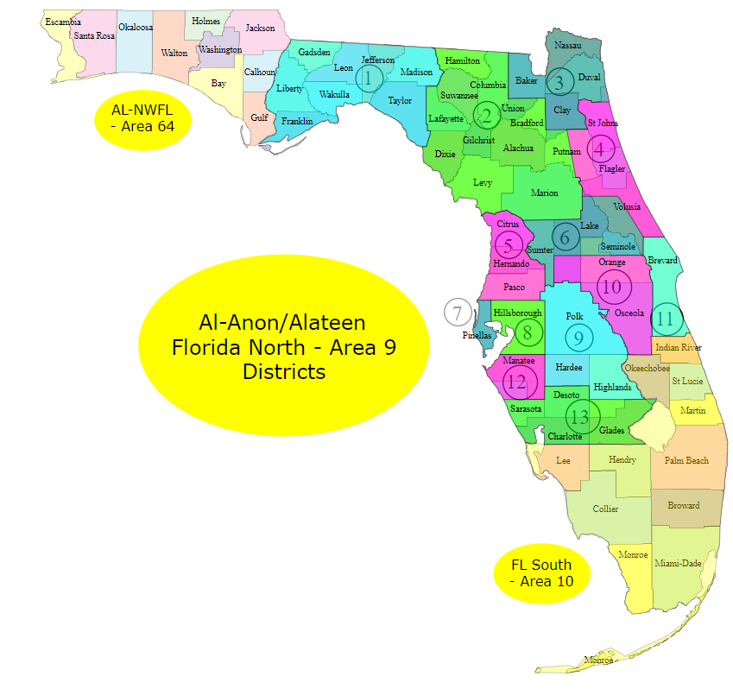

Slide 9
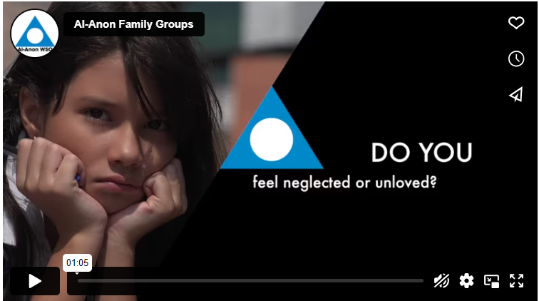
WSO Public service announcement
https://al-anon.org/media-kit/public-service-announcements/
Al-Anon public service announcements (PSAs) reach hundreds of millions of people every year throughout the US and Canada, thanks to the generous commitment of TV and radio stations to offer free airplay.
While the faces and voices featured in the PSAs are those of actors, the scripts are exclusively Al-Anon in content and carry the Al-Anon message of help and hope to the public.

Slide 10
WSO PRODUCES
The Public Service Announcements (PSAs) contracts a vendor to handle the distribution to 22,000 – plus commercial radio and TV Stations in the United States and Canada.
The PSAS are available in English, French and Spanish
The current campaign is posted in al-anon.org
The video is for viewing only and not distribution.
While the WSO handles distribution to commercial radio and TV stations in the US, including Puerto Rico, Canada and Bermuda, it does not reach the local entities.

Slide 11
plan
1. Reach out to the local media
Television in all 13 districts
Radio in all 13 districts
Religious radio in all 13 districts
Colleges and University Stations in all 13 Districts
Provide information about Al-Anon Alateen
Ask station managers to play our PSAs
Send interested stations’ information to WSO
WSO will supply the stations with the appropriate PSA

Slide 12
College stations in florida north
District 1 – FAMCAST The Florida A&M University Digital Media System https://www.famu.edu/famcast/wanm.php District 2 – WUFT – FM Radio station University of Florida in Gainesville https://www.jou.ufl.edu/home/main-immersion/inc/ District 3 – Spinnaker – University of North Florida in Jacksonville https://unfspinnaker.com/tv/ District 4 – WFCF - Flagler College Radio – St. Augustine https://www.flagler.edu/news-events/wfcf-flagler-college-radio | District 5 – WUCF – University of Central Florida radio https://www.wucf.org/listen/ District 6 – WDSC – TV15 - Daytona State College Television https://www.daytonastate.edu/in-the-community/wdsc/index.html District 7 – 99.9 WECX – Eckard College Radio Station https://www.facebook.com/EckerdWECX/ District 8 – Hawk Radio – Hillsborough County Community College https://www.hccfl.edu/campus-life/hawk-radio

Slide 14
THANK YOU
Carmen S
Public Outreach Coordinator
publicoutreach64@afgarea9.org
813-326-9108

