Slide 1
Alateen Training Module IV Alateen Events
Florida North Area
Panel 64
Notes:
1
Key points for facilitators:
This section covers Alateen events, and the information needed for both planning and participation.

Slide 2
Events with Alateen Participation
Area Alateen Conferences
Area Alateen Roundups
Area Assemblies and other service meetings
Al-Anon/Alateen Conventions
A.A. Conventions with
Al-Anon/ Alateen participation
Notes:
2
Key points for facilitators:
Special events in our fellowship provide an opportunity for Alateen and Al-Anon members to share recovery.
We want to include Alateen in our Al-Anon family events, but as with all things Alateen, we need to be sure they are safe.

Slide 3
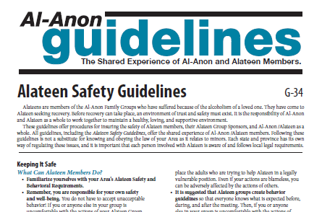
Alateen Safety
All events using the Alateen name in the Area must have Safety and Behavioral Requirements that meet or exceed the Area Safety and Behavioral Requirements.
Notes:
3
Key points for facilitators:
The Area Alateen Safety and Behavioral Requirements apply to all events that use the Alateen name.
Suggested Question: What are the essential things needed for Alateens to participate in an event?
Reference:
Wording from Alateen Motion:
“…if an Area within the World Service Conference Structure uses the Al-Anon or Alateen name in conjunction with any meeting(s), group(s), convention(s), or any other gathering(s) in the Area where Alateen participation is offered, the Area must have safety and behavioral requirements for all Alateen members and Al-Anon Members Involved in Alateen Service. These safety and behavioral requirements must meet the minimum requirements of Al-Anon Family Group Headquarters, Inc.”

Slide 4
Needed for all events using the Alateen name
Connection with the Area
Plan for implementing Safety Requirements at the event – consent forms, medical forms, contact information, etc.
Certified Al-Anon Members Involved in Alateen Service (AMIAS)
Notes:
4
Key points for facilitators:
Any event using the Alateen name must have a connection to the Area/district in which it is held.
Alateens must be in the care of Area-certified Al-Anon Members Involved in Alateen Service at all times.
The event must have a plan for implementing and adhering to the Area Requirements.
Note that all teens (even those 18 and older who are legally adults) must abide by all Alateen event requirements.
Suggested question: How can we determine current AMIAS status? (What is the importance of doing so? Who is responsible to do so?) Remember that the WSO ID number merely identified individuals in the WSO database. It is not connected to AMIAS certification.
Reference:
2014-2017 Al-Anon/Alateen Service Manual, page 90

Slide 5
Verification of current AMIAS certification must be obtained from your Area.
Contact your AAPP for status of AMIAS at event
Notes:
5
Key points for facilitators:
Suggested question: How do we verify current certification in our Area?

Slide 6
Implementing Area Alateen Requirements at Events
Make sure the entire Area understands the Area requirements and implementation plans
Ensure 24/7 AMIAS supervision
Procedures for dealing with problems
Safety/health emergencies
Behavioral/compliance problems
SEE Florida North Area Alateen Safety and Behavioral Requirements on our Area website: www.AFGArea9.org
Notes:
6
Key points for facilitators:
It’s very important to communicate plans and processes
Put safety first:
Decide on ratio of AMIAS to Alateens
Keep gender and sexual orientation in mind
Prepare for possible problems
When faced with a new situation, talk to each other and reason things out
Reference:
Members’ Web site, www.al-anon.org/members, Alateen section on “Alateen Participation in Events”
Alateen Conferences guideline (G-16)
Alateen Safety Guidelines (G-34)

Slide 7
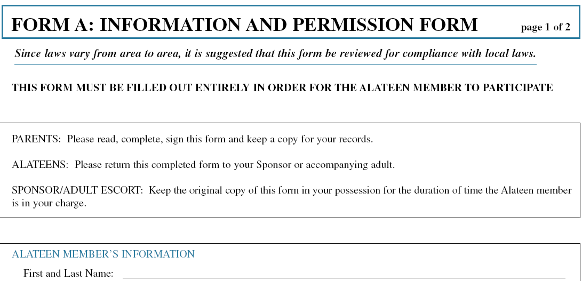
Permission Forms
Area Requirements will determine when permission forms are necessary.
Generally, they are used for all special events, including overnight events, and any time transportation is provided to an Alateen by an Area-certified Al-Anon Member Involved in Alateen Service.
Notes:
7
Key points for facilitators:
The Area Requirements will determine when permission forms must be obtained.
Note that events may have requirements that exceed the Area Requirements. For example, the Area may not require permission forms when an Alateen is transported locally by their parents or a family friend. But an Alateen Conference may require that any Alateen attending the conference requires a transport permission form, no matter who drives them.
Medical release forms are an important part of the permission process; Areas and events need to check with local legal counsel regarding the necessity for notarization. Most locations require a notarized form for medical release.
Only Area-certified Al-Anon members can transport Alateens “in service to Alateen,” and parental permission forms are required whenever transporting Alateens.
All Alateens (including those aged 18 and older who are legally adults) are treated the same at Alateen events.
Suggested question: When are we “in service to Alateen”?
References:
Alateen Conferences guideline (G-16)
Alateen Safety Guidelines (G-34)

Slide 8
Al-Anon/Alateen Conventions
Alateen is part of Al-Anon Family Groups.
Alateen participation must adhere to the Area’s Alateen Safety and Behavioral Requirements.
Can be a shared recovery experience for all Al-Anon/Alateen members.
A great opportunity for Area-certified Al-Anon Members Involved in Alateen Service (AMIAS) to be of service to Alateen and support the regular Alateen Group Sponsors!
Notes:
8
Key points for facilitators:
Alateen participation in our conventions can help to unify our Al-Anon Family Groups. Planned Alateen participation in Al-Anon conventions can help to make Alateens and adult Al-Anon members more comfortable with each other.
Alateen participation in our conventions must follow the Area Safety and Behavioral Requirements.
Just as at Alateen meetings and at Alateen Conferences, at our conventions Alateens must be in the care of Area-certified Al-Anon members or their parents/guardians at all times.
Discussion question: How can AMIAS support the Alateen Group Sponsors at events?
References:
Al-Anon/Alateen Area Conventions (G-20)

Slide 9
Area Business Meetings
Including:
Assemblies
Area World Service Committee (AWSC)
Also follow Area Alateen Requirements.
Notes:
9
Key points for facilitators:
Alateen participation in Area business meetings must follow the Area Safety and Behavioral Requirements.
Just as at any other gathering, Alateens must be in the care of Area-certified Al-Anon members or their parents/guardians at all times.
For discussion: What steps can an Area take to encourage Alateen participation in Assemblies? How can Assembly members who are not Alateen Group Sponsors help?

Slide 10
Alateen participation at the Florida North Convention
Alateen Chair on the Convention Committee coordinates the AMIAS volunteers, the Alateen program and sets up all information for registration and compliance with Area Safety and Behavioral Requirements.
AMIAS volunteers, parents, grandparents and all Al-Anon members are important to success!
Notes:
10
Key points for facilitators:
[add info on Area Alateen participation in convention]
References:
Al-Anon/Alateen Area Conventions (G-20)

Slide 11
A.A. Conventions with Al-Anon/Alateen Participation
A.A. may invite Al-Anon and Alateen to participate in its conventions or other events.
Alateen participation must adhere to the Area Alateen Safety and Behavioral Requirements. There can be no Alateen participation if Al-Anon is not invited to participate.
The A.A. planning committee must agree to adhere to the Al-Anon Area’s Requirements for Alateen participation.
Notes:
11
Key points for facilitators:
A.A. Conventions often invite Al-Anon/Alateen participation. These events provide a shared recovery experience. As use of the Alateen name requires adherence to the Area Safety and Behavioral Requirements, Al-Anon must participate in the convention in order for Alateens to participate.
It is important to explain our Safety and Behavioral Requirements to the A.A. planning committee, so that there is no misunderstanding of our policies.
References
Cooperation between Al-Anon and A.A. guideline (G-3)
Al-Anon/Alateen Participation in an A.A. Convention (G-7)

Slide 12
Alateen Conferences
Opportunity for Alateens and Al-Anon Members Involved in Alateen Service (AMIAS) to enhance their recovery through sharing of ideas, fun, and fellowship
Increased sharing experience with wider Alateen membership
Notes:
12
Key points for facilitators:
Question: What is the purpose of Alateen conferences? Why are they important?
Alateen Conferences are often the high point of the Alateen members’ year—these fellowship events allow Alateens to connect with others from outside their immediate circle, to connect with a wide range of recovering young people.
First and foremost, Alateen Conferences are a recovery experience for Alateens. The Al-Anon Members Involved in Alateen Service (AMIAS) are there to help the teens have this experience. Both Alateens and the AMIAS involved will increase their understanding of the Twelve Steps, Twelve Traditions, and other tools of recovery. A secondary benefit is the opportunity for Alateen Group Sponsors and other AMIAS to share with and support each other. We want the focus to be on having a safe weekend of fellowship, recovery, and fun, keeping the focus on Al-Anon/Alateen principles.
Resources:
Alateen Conferences guideline (G-16)
Alateen Safety Guidelines (G-34)

Slide 13
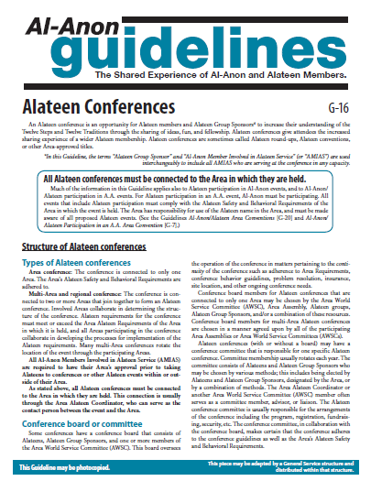
Alateen Conferences
Must be connected to the Area in which they are held (“host Area”).
Conference requirements must meet or exceed the host Area requirements and must be approved by the host Area.
All Al-Anon Members Involved in Alateen Service (AMIAS) are required to have their Area’s approval prior to taking Alateens to Conferences or other events.
Notes:
13
Key points for facilitators:
All Alateen Conferences must be connected to the Area structure in order for members to participate.
The Area in which a conference is held must approve the Conference safety and behavioral requirements.
Resources:
Alateen Conferences guideline (G-16)
Alateen Safety Guidelines (G-34)

Slide 14
Alateen Conferences
Are closed events, for Alateens and certified Al-Anon Members Involved in Alateen Service (AMIAS) only.
An Alateen Conference with an open meeting(s) needs to have:
a process to identify the Area-certified Al-Anon Members Involved in Alateen Service
a safety plan to insure that Alateens are always in the care of the Area-certified AMIAS present
Notes:
14
Key points for facilitators:
As previously stated, an Alateen Conference’s purpose is to enhance the recovery of the attending Alateens. Alateens must be in the care of Area-certified AMIAS at all times. In a conference setting where only Alateens and Area-certified Al-Anon members are in attendance, this is fairly simple.
If the conference offers open meetings, where other Al-Anon and A.A. members or other adults are present, then a safety plan should be in place to clearly identify the Area-certified AMIAS, and to make sure that Alateens are always properly supervised. The Area(s) need to be aware of this plan in order to determine if the conference meets the Area requirements.
Resources:
Alateen Conferences guideline (G-16)
Alateen Safety Guidelines (G-34)

Slide 15
Al-Anon/Alateen Literature and other Materials
Planning resources:
Alateen Conferences guideline (G-16)
Alateen Safety Guidelines (G-34)
Cooperation between Al-Anon and A.A. guideline (G-3)
Members Interested in Speaking guideline (G-1)
Al-Anon/Alateen Service Manual (P-24/27)
Program resources:
Conference Approved Literature
Alateen Talk & sharing sheets
The Forum
Area and WSO Web Sites
Alateen Service e-Manual on
www.al-anon.org/members
Notes:
15
Key points for facilitators:
There are many resources for planning Alateen events. Much of the material covered today is from the Alateen Conferences guideline (G-16).

Slide 16
Wrap Up
Contact for questions - Alateen Event Chairperson
(check with Alateen Coordinator)
Area Alateen Coordinator:
Judy S – Alateen-64@AFGArea9.org
Area Alateen Process Person (AAPP):
Karyn M – AAPP-64@AFGArea9.org
Notes:
16
Key points for facilitators:
These are your local resources…

Slide 17
Wrap Up
Alateen Conferences and other recovery events can enhance the Alateen experience.
Planning these events takes care and understanding of your Area Alateen Requirements.
The principles of the Twelve Steps, Twelve Traditions, and Twelve Concepts of Service should be practiced in all aspects of Alateen events.
Enjoy!
Notes:
17
Key points for facilitators:
This concludes Alateen Training Module – Alateen Events.
The next training will be: [insert info]
Keep it Al-Anon/Alateen!

