Slide 1
The Forum:
Sharing Recovery, Unity, and Service.
Notes:
Welcome, My name is…, Thank you for taking time out of your busy schedules to be here with us today. We are so appreciative of you and everything you do to support Al-Anon.
<7 sec. until next slide>

Slide 2
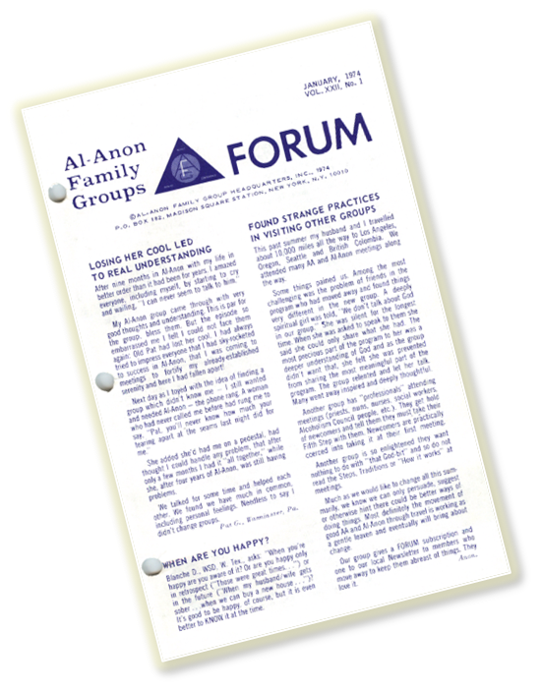
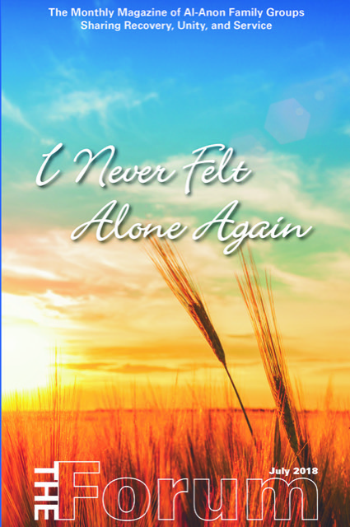
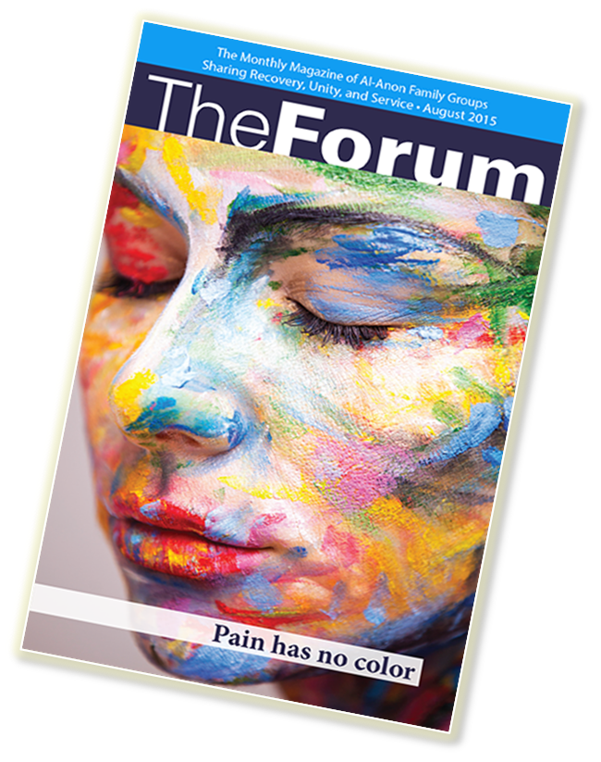
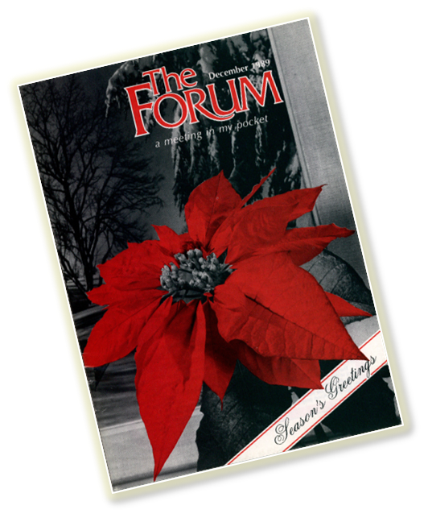
The Forum began as a monthly newsletter in 1954 titled Al-Anon Family Groups Forum. In 1978 it expanded into a magazine with its current title.
Notes:
The title was the result of a request to the fellowship from Cofounders Lois W. and Anne B for suggestions. It was adapted from the title of a newsletter for early family groups, The Family Forum, that Ruth G. of San Francisco began in the 1940s and discontinued shortly after the Clearing House (our first World Service Office) began.
<28 sec. until next slide>

Slide 3
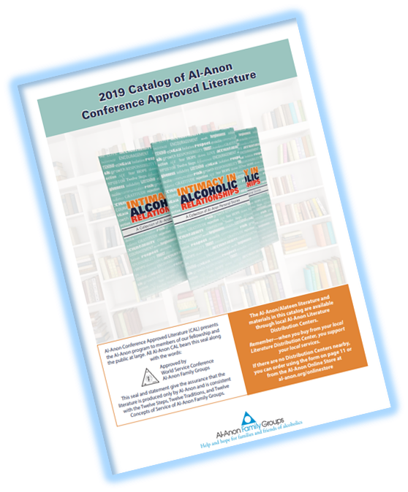
The Forum, as a concept, is Conference approved.
Notes:
As it states on page 113 of the 2018-2021 Al-Anon/Alateen Service Manual, “The Forum can be used, and is encouraged to be used by members and groups for meetings. The Forum, as a concept, is Conference Approved…” Due to time constraints, it is not possible for each issue of The Forum to follow the full procedure that our Conference Approved Literature does, but each sharing received is reviewed by a volunteer committee for fidelity to the Al-Anon program and principles. Articles from The Forum make excellent meeting topics and can generate a lively group discussion!
<29 sec. until next slide>

Slide 4
In The Forum, Al-Anon and Alateen members share their challenges, insights, and progress along their paths of self-discovery and spiritual growth. It has been a vital part of recovery for many members.
Notes:
As the monthly magazine of Al-Anon Family Groups, The Forum serves as a reflection of the current state of the fellowship. It is often the first place where members share about breakthrough topics, like the effects of having grown up with alcoholism (first included in the 1970s), alcoholism and sexual abuse (first included in the 1980s), as well as alcoholism and grief (first included in the 1990s).
<29 sec. until next slide>

Slide 5
Your Group Representative is also your Forum Representative
Notes:
As your group’s Forum Representative, your Group Representative encourages individual members and your group to subscribe to The Forum, as well as to submit sharings and photos to the magazine and to use it for meeting topics. For more information, read Tips for GRs as Forum Representatives (F-2) at al-anon.org/pdf/F2.pdf.
<15 sec. until next slide>

Slide 6
Notes:
The Forum shares stories from members at all stages of recovery and all walks of life. It also keeps us informed about new literature, policy changes, valuable resources for carrying our message, and ideas for keeping our groups strong and thriving. The Talk to Each Other section is a way for members to receive feedback from other members regarding topics that concern them.
<25 sec. until next slide>

Slide 7
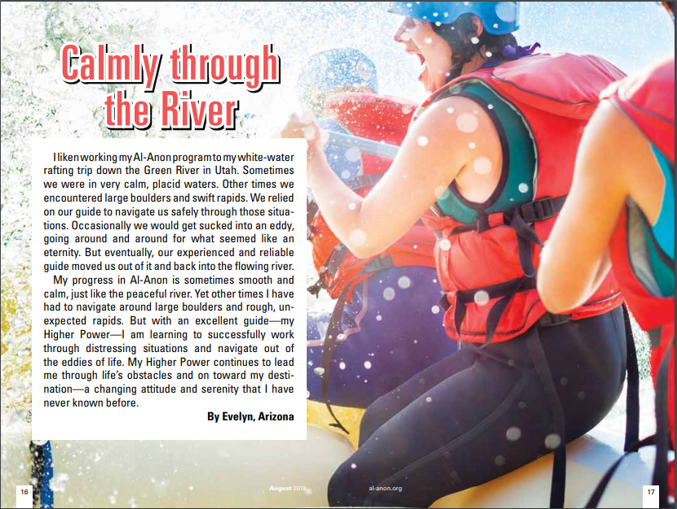
The Forum is now in full color!
Notes:
For the first time in its 60-plus year history, in January 2018 The Forum began to be printed in full color.
<20 sec. until next slide>

Slide 8
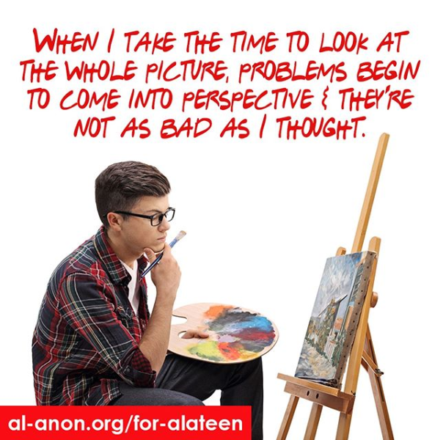
The Forum is quoted on Social Media
Posts made to our social media platforms are from monthly issues of The Forum.
We have reached over 5 million people across the world with our social media platforms. ​
Notes:
Social Media is the new wave of communications used to reach potential Al-Anon members. The Forum provides approximately 70% of the content on our Facebook pages, so it’s very valuable in terms of our public outreach efforts. Additionally, three Forum sharings are posted on Al-Anon’s website, al-anon.org, each month to attract newcomers. It helps spread our message faster than conventional methods previously used. Our Al-Anon social media platform is available in English, French, and Spanish. Our Alateen platform is currently English only.
<28 sec. until next slide>

Slide 9
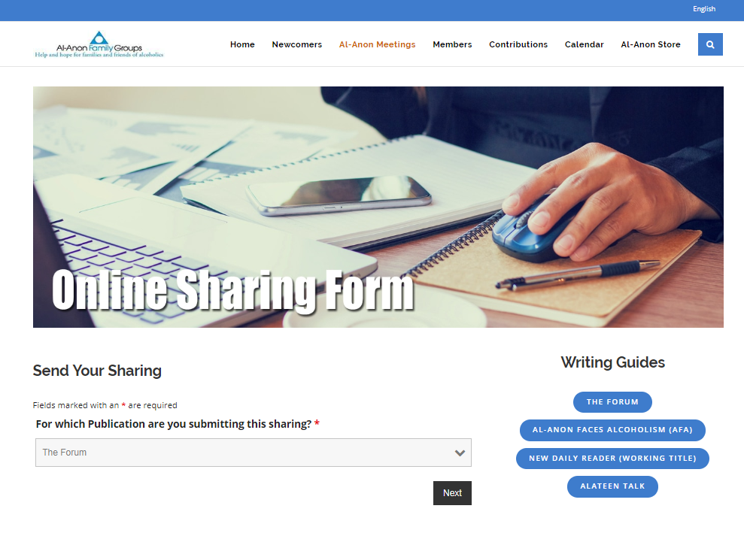
Stories in The Forum come from our members. Have you considered submitting a sharing?
Readers are encouraged to send in not only articles, but photographs, as well, to al-anon.org/forumshare
.
Notes:
The Forum magazine is always in need of sharings, particularly those aimed at newcomers, as well as sharings about the three Legacies (Twelve Steps, Traditions, and Concepts of Service), and from Alateen members and Alateen Group Sponsors.
<20 sec. until next slide>

Slide 10
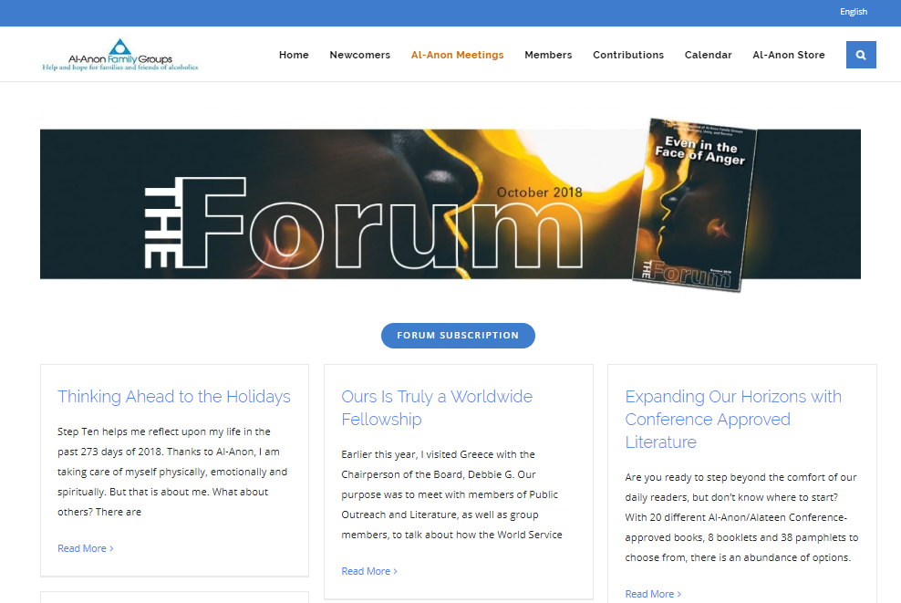
The Forum is also available in an electronic version at al-anon.org/electronic-literature
You can order The Forum at
al-anon.org/forum
Notes:
On our website, al-anon.org, you can order The Forum, Conference Approved Literature, submit sharings, and photos to be considered in future Forum issues. Our many great departments make The Forum possible along with Group Representatives, who are representatives of the magazine, so it is important that we discuss it and encourage readership, subscriptions, and submissions.
<30 sec. until next slide>

Slide 11
How has The Forum
helped you with your recovery?
Notes:
Open floor for discussion

